Slide 1
FILM STUDIES
Unit: Exploring Film Form
Lesson 2
Your Name

Slide 2
What is the purpose of cinema?
Why do people go to the cinema?
What role, if any, does cinema serve in society today?

Slide 3
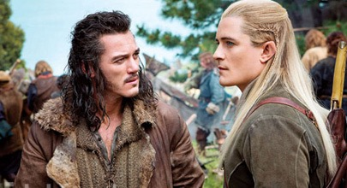
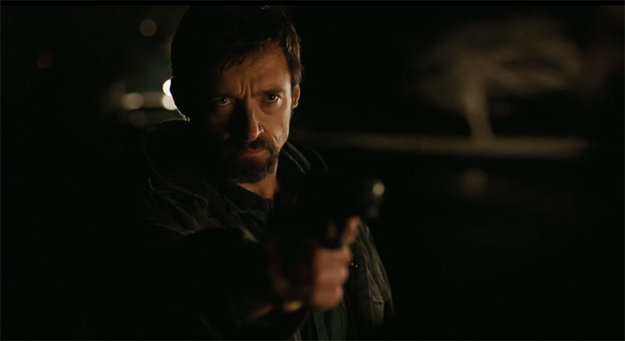
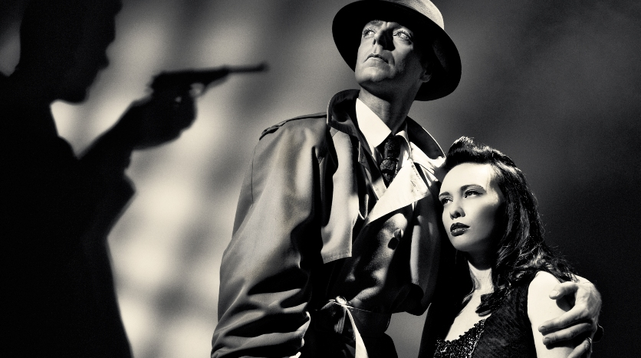
Lighting
Color

Slide 4
Pre-Production reflection
What have you done?
What did you do well, and what did you have problems with?
How did you resolve problems?
What will you do next?

Slide 5
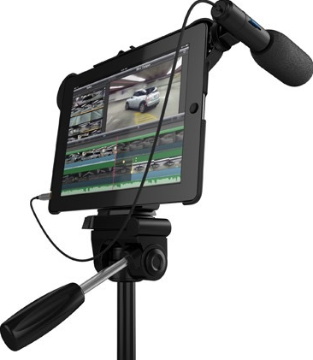
Production formative assessment

